Slide 1
SA-3000P
Result Reading Guide

Slide 2
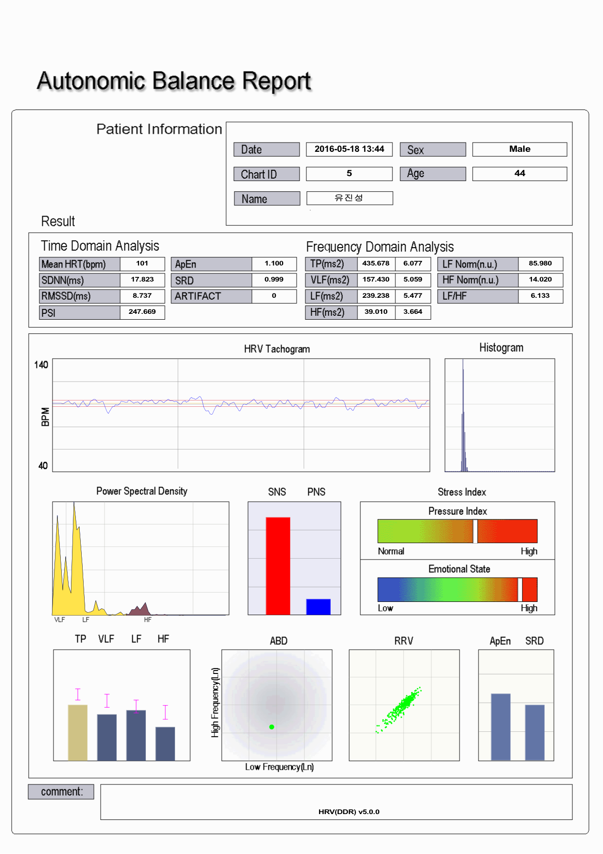
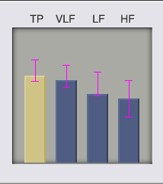
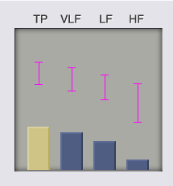
1. Autonomic Balance Report
TIME DOMAIN ANALYSIS
SDNN: Representative parameter to indicate HRV degree. Decreased SDNN indicates ANS (Autonomic Nervous System) dysfunction.
SDNN Value | Over 50 | Over 30 | 20~30 | Below 20
Status | Healthy | Normal | Attention | Consulting
HEART RATE VARIABILITY (HRV):
Measures the degree of fluctuation in the length of intervals between heart beats. For healthy people, HRV a fluctuation in heart rates, while unhealthy people have a simple and consistent heart rate.
HRV measures the adaptability of the cardiovascular system and autonomic
nervous system, which is composed of the sympathetic nervous system
(SNS) and parasympathetic nervous system (PNS). Your SNS plays the role of the accelerator, also known as flight or fight. Your PNS functions as the brake, also known as rest and repair. A healthy person has a balanced autonomic nervous system.
FREQUENCY DOMAIN ANALYSIS:
TP: Total Power, combination
of the 3 frequencies
VLF: Very Low Frequency
LF: Low Frequency
HF: High Frequency
Reduction of TP: Decreased ANS function, decrease in regulatory
competence and a decrease in the ability to cope with environmental change.
Reduction of VLF: Decrease in the bodies ability to regulate body
temperature and hormone levels.
Reduction of LF: Loss of energy, fatigue, insufficient sleep and lethargy.
Reduction of HF: Chronic stress, aging, reduced electrical stability of the heart.
Healthy
Unhealthy

Slide 3
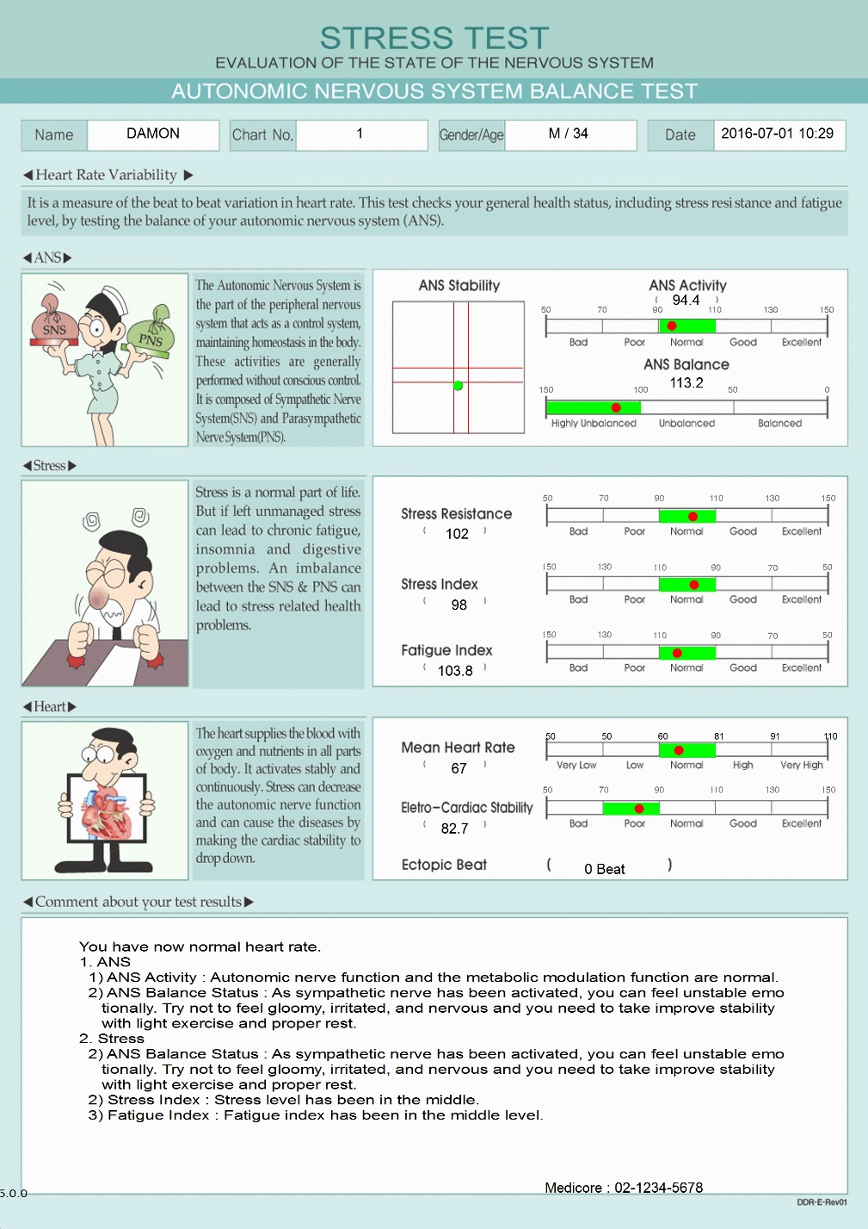
2. Stress Report (DDR Report)
ANS (Autonomic nervous system)
ANS Activity : It’s derived from TF (Total Power) on the Frequency Domain. The result is divided into 5 level and indicates the activity of ANS function and its regulation competence.
ANS Balance : It’s derived from LF / HF ratio on the frequency domain. If unbalanced ANS is sustained for a long time, increase the risk of cognitive or somatic pathology.
ANS Stability : Indicates Autonomic Balance on the Diagram.
Stress Resistance : It’s derived from SDNN on Time Domain. The competence to maintain metabolic balance and stability against stressor or environmental changes.
Stress Index : It’s derived from PSI (physical stress index) on Time Domain.
Fatigue Index : It’s derived from overall tone of LF (SNS).
Reduction of LF(SNS) causes the ‘loss of energy’ and fatigue.
Electro-Cardiac Stability : It’s derived from overall tone of HF (PNS) on Frequency Domain. HF reflects the activity of parasympathetic nervous system (Vagus nerve) and it’s related to electro-cardiac stability.
Ectopic Beat : It means abnormal beat likes arrhythmia or artifact. If ectopic beat is more than 5, re-measurement is required

Slide 4
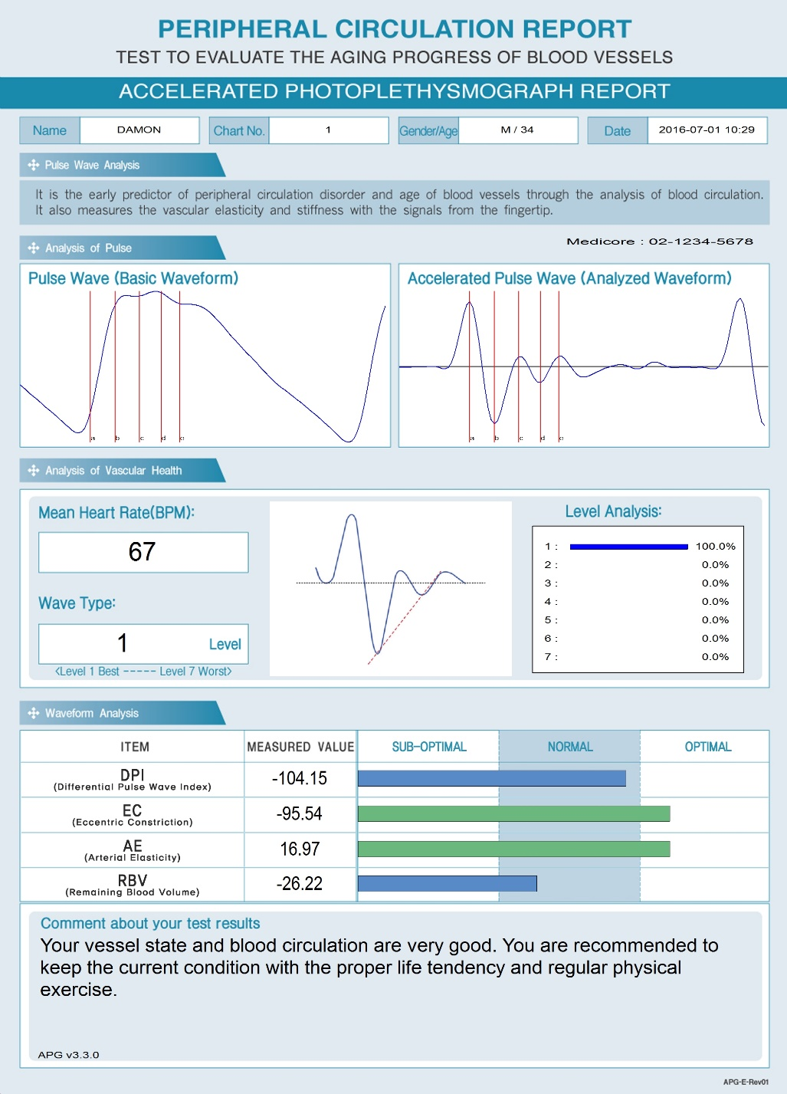
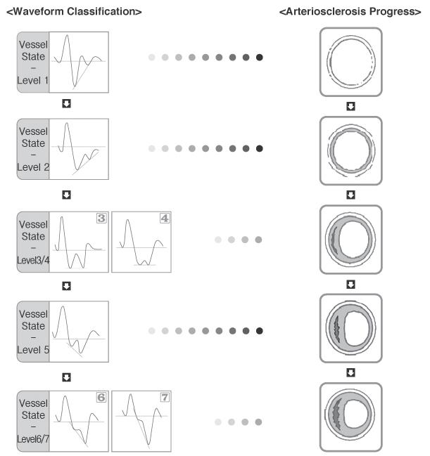
3. APG Report
Level1: Blood circulation and
artery state is great!
Level2: Blood circulation and
artery state is good but a slight
build up is beginning to occur.
Level3~4: Blood circulation
and artery state is becoming
poor and build up is starting.
Level5: Blood circulation and
artery state is bad and build up
is increasing.
Level6~7: Blood circulation and
artery state is very bad and
build up is becoming serious.
DPI(Differential Pulse Wave Index) : Represents the overall health of the
cardiovascular system. DPI is the main indicator that represents the aging of arteries.
EC(Eccentric Constriction) : Represents the contraction power of vessels
from the left ventricle.
AE(Arterial Elasticity) : Analyzes the blood circulation, the vascular elasticity and resistance of the vessels. It detects early cardiovascular disease like atherosclerosis and peripheral circulation dysfunction.
RBV(Remaining Blood Volume) : The remaining blood volume in the vessels after systolic contraction on the heart. If the blood vessels are healthy, there is little remaining blood volume. If the vascular state improves, the remaining blood volume will decrease.

