Slide 1
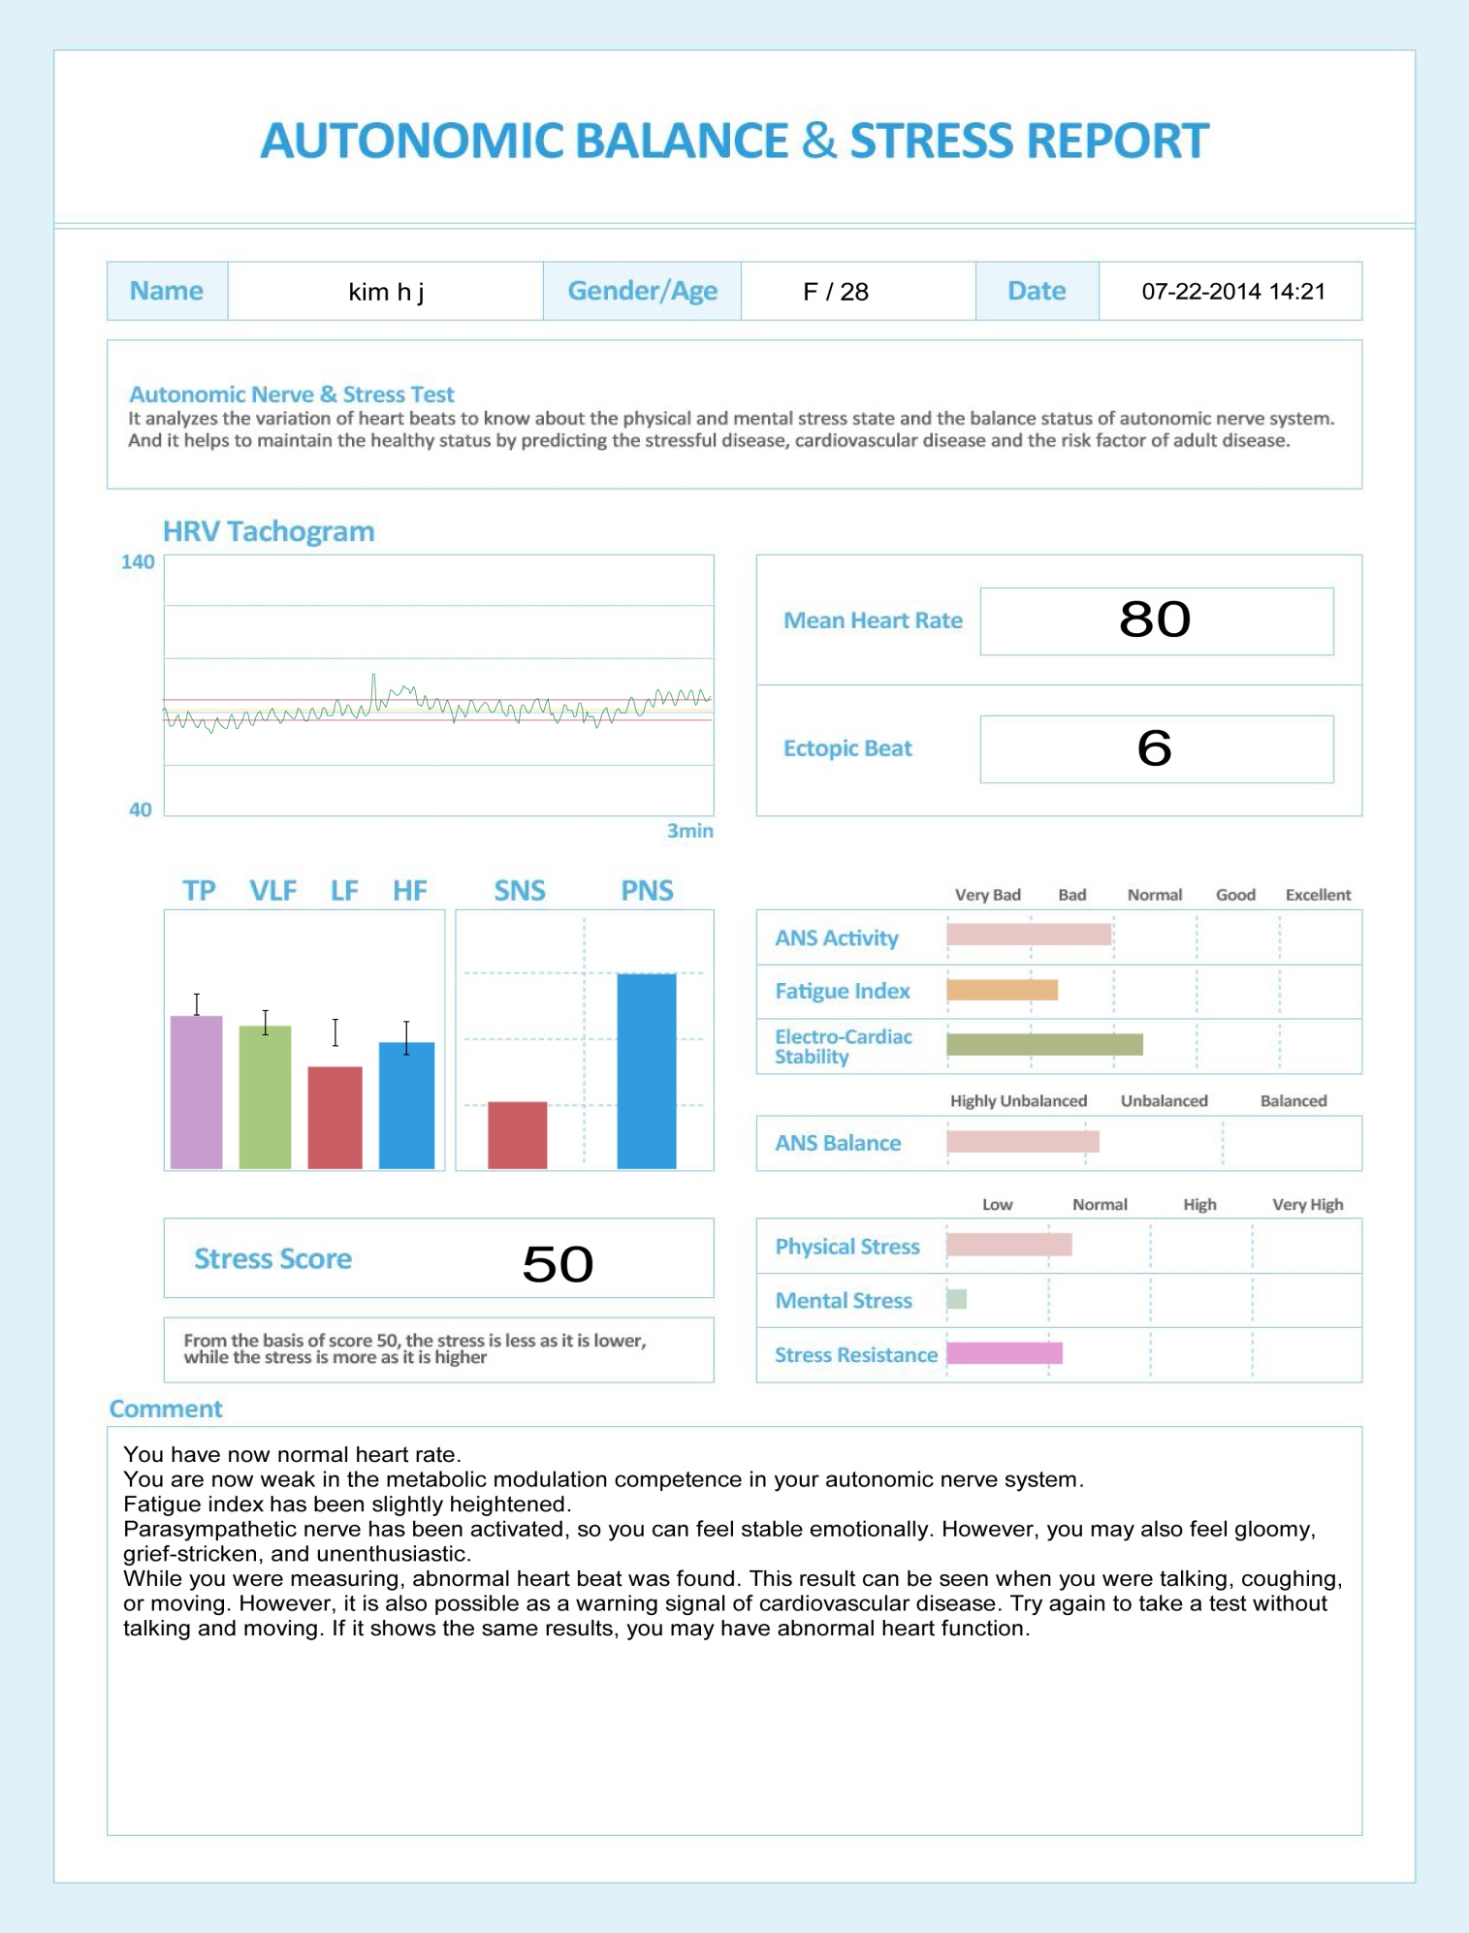
Max Pulse Result Reading
1
2
3
4
6
5
7
8
9

Slide 2
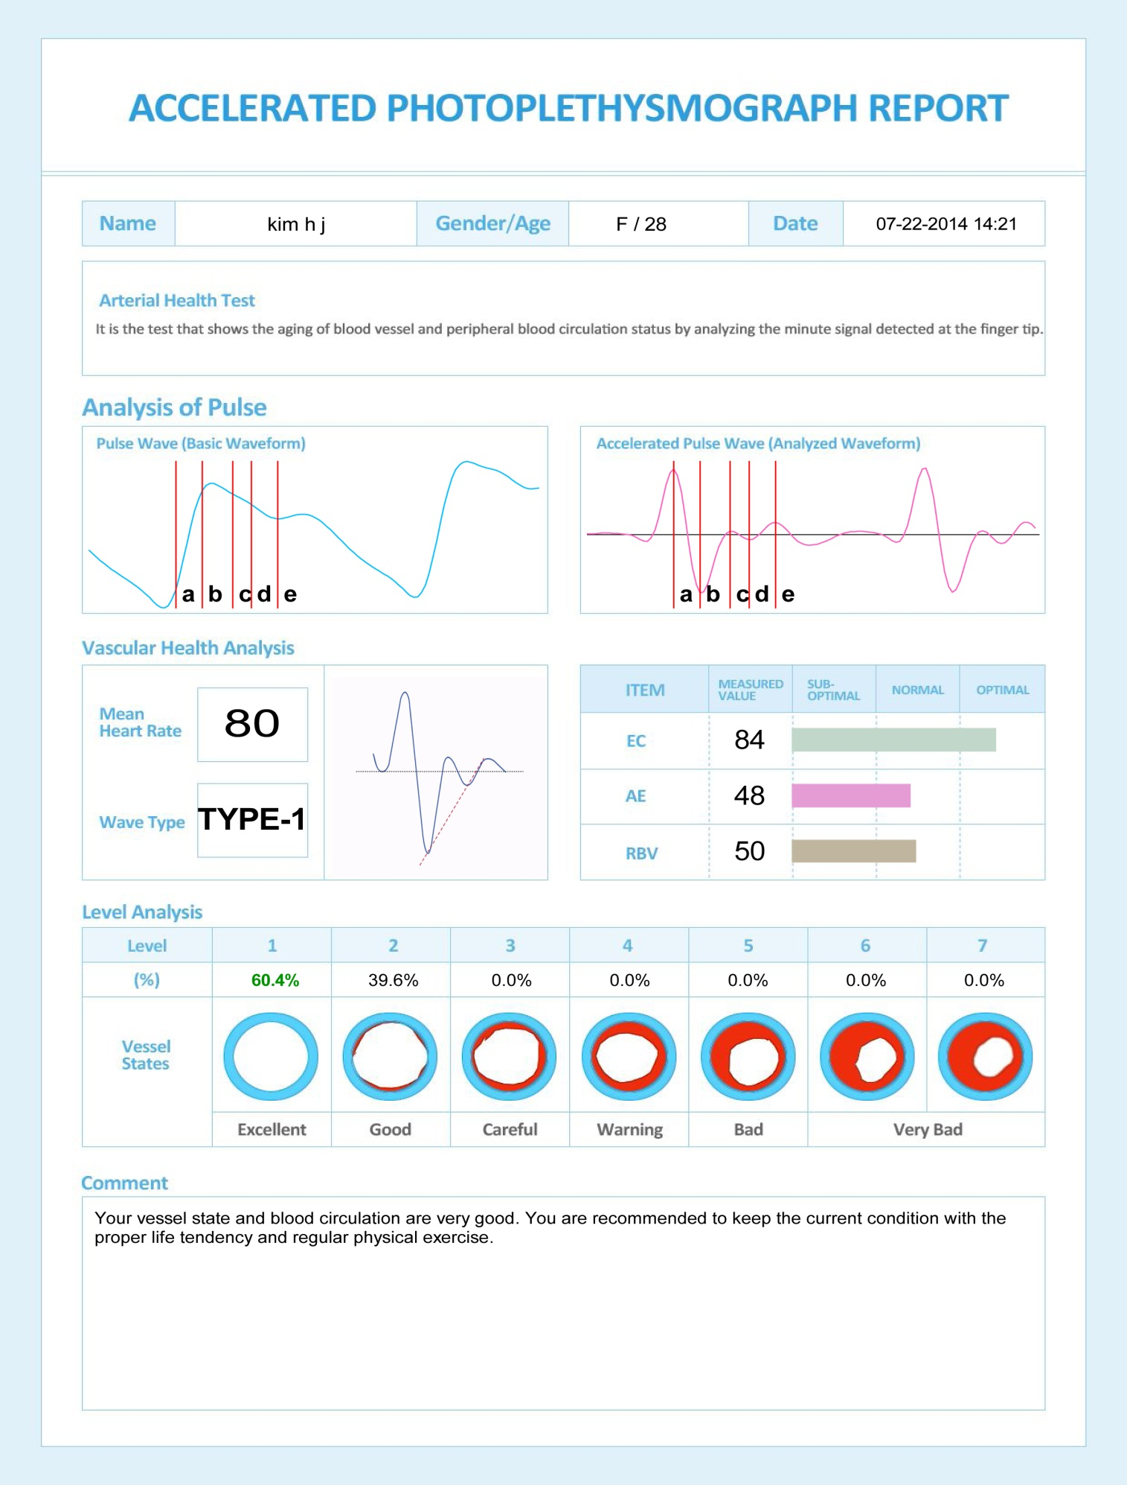
Max Pulse Result Reading
10
11
12
13

Slide 3
1
HRV Tachogram presents the fluctuation (up and down) of heart rate during 3 minutes . Larger fluctuation of HR is equivalent to the wider of red line which mean healthy. The moving or coughing during the measurement causes big wave on the Tachogram which makes inaccurate result.
2
Mean Heart Rate: is the average heart rate during 3 minutes.. The normal HR of adult is 60 ~ 90 bpm.
3
Ectopic beat : It means the rhythms deviated from the normal range and also it may be appeared when the
person moves during the test or he or she has an arrhythmia. If it shows over 5 times, should be
tested again. If you experience palpitation, breathing difficulty or syncope frequently, discuss with
your doctor.
4
TP : It combines VLF, LF and HF and if it is located in “I” bar or over the bar, it means that the autonomic nervous system functions well but if it is under the bar, it means the autonomic nervous system functions badly and the stress resistance ability is also weak.
VLF : It doesn’t mean too much in diagnosis at 3 minute test mode, but it may be appeared to those who have too much changes in hormone or inconsistent characters.
LF : It shows the activity of sympathetic nerve and parasympathetic nerve at the same time, but it mostly indicates the sympathetic nerve system. If it is located under the normal range, it means that he or she has lethargy, sluggishness or sleep disorder.
HF : It shows parasympathetic nerve system and if it goes under the bar, it causes a lack of stability in heart function, chronic stress, functional dyspepsia, and senility.
5
It indicates the balance between sympathetic nerve and parasympathetic. And its normal rate is 6:4, 5:5 or 4:6. If SNS is too much higher, it is highly nervous state. If PNS is too much higher, it means the depression, lethargy, or lack of will.
6
ANS Activity: It indicates the activity of Autonomic Nervous System function and its regulation competence.
Fatigue Index : It indicates the state of fatigue and “loss of energy caused from stress.
Electrio Cardiac Stability: It is decreased because of chronic stress and lowered Electro Cardiac Stability may
make a risk of cardiac disorder.
7
Stress Score : It displays in score for the stress. The middle of score is 50 and higher score means heavier stress.
Lower than 50 means health state.
8
Physical Stress : It shows the stress level in physical state.
Mental Stress : It shows the stress level in mental state.
Stress Resistance : It means the ability that sustains the stability of control against the stress.
9
Comment : : It gives the general result of all tests.
10
Aging Vascular Health : It is classified for the aging process of vessel from type 1 to type 7 and displays the vascular state of each type in percent(%). Type 1 shows the best vascular state and when the senility is under progress, it makes higher types.
11
EC (Eccentric Constriction) : It means the cardiac output power from left ventricle to artery.
AE (Arterial Elasticity) : The wave reflected from elasticity of vascular wall when to output blood in heart.
RBV (Remaining Blood Volume ) : It means the remaining blood volume after cardiac constriction. (The smaller the value is, the better the health is) All parameters mean the normal as a good state and the optimal is much better.
12
Wave Type : It displays the representative type that has more percentages out of all types. Type 1 – As the best type, it has the best blood circulation and good elasticity.
Over Type 5 – It gets more aged in the vessel and may have arteriosclerosis, high blood pressure or diabetes.
13
Comment : It gives general result of all vascular tests.

